Slide 1
Securing Docker on the Cheap
Part 2 - Vulnerabilities

Slide 2
About Me
Possessor of many hats
Currently at LO3 Energy
Formerly of Autodesk
This talk brought to you by the letter ‘A’
Notes:
A bit of a generalist, with experience in development, sysadmin, architecture, security, and even tech support.
Currently at LO3 Energy - a block-chain powered energy microgrid startup
Began working with containers while Autodesk, where I design and implement on a SOC2 compliant Docker based service
Much of this presentation is inspired by work on Docker security and compliance efforts at Autodesk

Slide 3
But first….

Slide 4
The whale in the room
Notes:
This talk is focused on Docker container technologies. The speaker fully acknowledges that not a all containers are Docker containers.
Part 1 is mostly about what you can do with Docker itself.

Slide 5
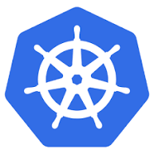
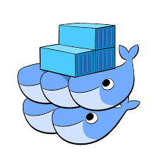



Orchestration platform agnostic
Notes:
This presentation does not assume any particular orchestration solution, or any orchestration at all. While how these techniques are leveraged may vary depending on the orchestration platform, they use primarily what Docker does out-of-the-box.

Slide 6
Solid
Foundation

Slide 7
Security Starts at the Top
Notes:
One of the most basic, yet most effective security principles. To better understand, let’s take a look at a sample Dockerfile.

Slide 8
Sample Dockerfile
FROM ubuntu:16.04
RUN apt update && apt upgrade -y && apt install -y curl && \
curl -sL https://deb.nodesource.com/setup_8.x | bash - && \
apt install -y nodejs
EXPOSE 3000
ADD app.js /var/app/
ADD package.json /var/app/
WORKDIR /var/app
RUN npm install
CMD ["/usr/bin/node", "app.js"]
Notes:
This sample Dockerfile creates a simple Node/Express app using an Ubuntu 16.04 base.
There are few security issues with this Dockerfile, but we will, as previous stated, start at the top.
This one line can make a huge difference to the

Slide 9
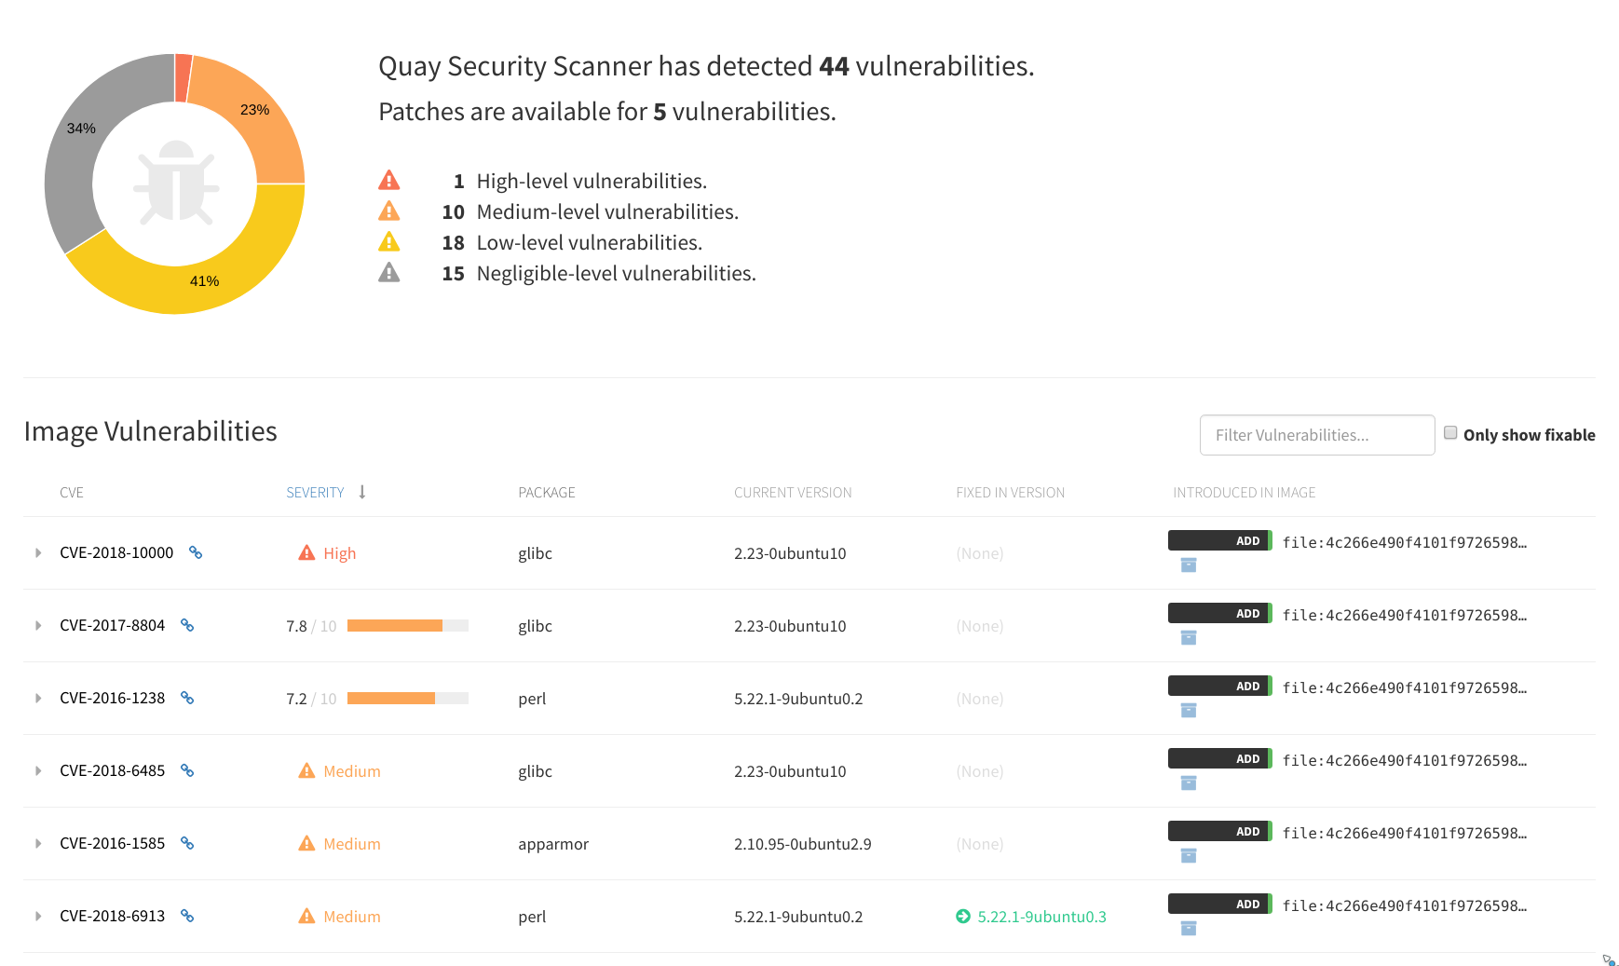
Security scan of ubuntu:16.04
Notes:
Quay.io (from the CoreOS folks) includes vulnerability scanning as part of its service. This is the vulnerability scan result for the base ubuntu:16.04 image.
It gets worse….

Slide 10
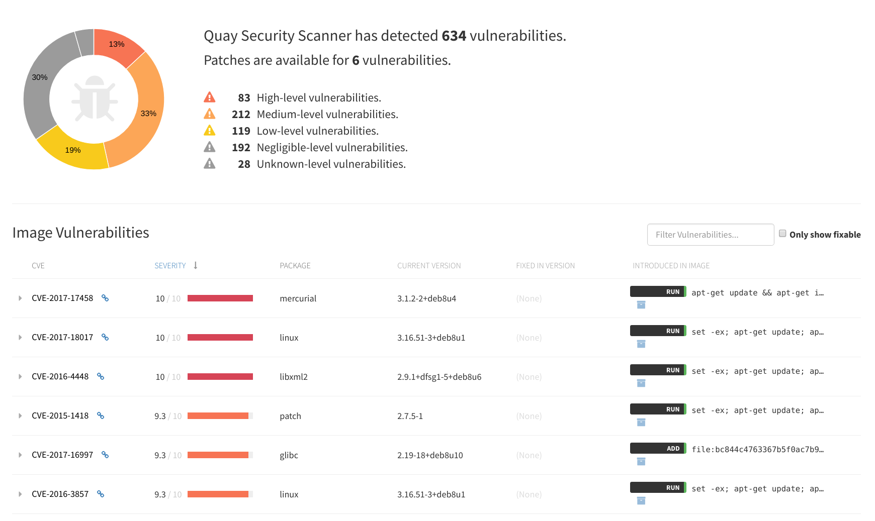
Security scan of node:9.11.1
Notes:
Yikes! This happens to be the latest (as of 2018-04-16).
If you’re building your container using FROM node and pulling this container from Docker Hub, you’re inheriting ALL OF THIS.
So, how do you get around this? Knowing, as they say, is half the battle. The other half of this particular battle: use your own base container for your services.

Slide 11
Creating a Custom Base Container
Notes:
Let’s review some rules for creating a custom base

Slide 12
Rules for a Quality Custom Base
Starting tiny is better
Patch as part of the build
Build a shared service base
  Install common tools
  Install base runtime
Leave the application specifics for downstream containers
Leverage any hardening standards/tools for the OS
Don’t setup a firewall - Docker networking takes care of this
Install only what you need!
Pro-tip: docker run -it [base-image]:[tag] /bin/sh to experiment
Notes:
When deriving from a public base, start with the smallest possible. Not only does this keep your container image smaller, but the smaller Linuxes tend to pre-load less bloat.
One note about tiny bases: they may work differently than the Linuxes you’re used to. Take some time to explore.
Add a patching RUN command in the Dockerfile for the base build, so everytime the base is rebuilt, it automatically installs the latest patches.
You’ll get more out of your time if you create one common base for all of your similar applications. Create a node-base for all of your Node work. Create a ruby-base for all of your Ruby work.
Pro-tip: experiment with the container build commands by running the base container interactive locally. This allow you to test all of the commands for the Dockerfile without having to build.

Slide 13
Scratch Containers
Docker images can be derived from tarballs
Docker containers need a filesystem
...but that does not need to be a full base OS filesystem
Docker images can be built directly
FROM scratch
Statically-linked executables (like Go) can be built directly into Docker images

Slide 14
Security
Validation
Notes:
Ok, so you’ve built your base or your container and you want to make sure it’s good. How can you know for sure it meets the security standard?

Slide 15


Slide 16
Validating Hardening Using InSpec
InSpec is a compliance auditing system from the makers of Chef
Compliance suites expressed in human-readable language
Integrates with test-kitchen
Can validate many different types of system
For Docker, two main use cases
  Validate/audit hardening work on containers
  Verify compliance of Docker hosts
The DevSec project is a great place to start
https://github.com/dev-sec
Notes:
If you’ve ever used RSpec, InSpec will feel very familiar.
InSpec can validate just about anything you can connect to. This could be a local machine, physical machine, virtual machine, cloud instance, or Docker container.

Slide 17
Demo
Notes:
Show an inspec rule
Show dev-sec project

Slide 18
Running InSpec On a Container
$ inspec exec https://github.com/dev-sec/linux-baseline -t docker://ae344d0a573
...
Profile: DevSec Linux Security Baseline (linux-baseline)
Version: 2.2.0
Target: docker://ae344d0a573c1e51767ad19cd4680d223bbc88e133f5e176037a33ae3a96db55
...
Profile Summary: 18 successful controls, 27 control failures, 9 controls skipped
Test Summary: 44 successful, 47 failures, 12 skipped
Notes:
Note: this is a general purpose InSpec library provided by the DevSec project - you’ll want to tailor your controls to your needs.

Slide 19

Notes:
Clair is an open source container vulnerability scanner created by the CoreOS folks. It looks for known vulnerabilities in containers by comparing packages in the filesystem with vulnerability data sourced from Debian, Ubuntu, RedHat, Oracle, Alpine, and NIST.
It is designed to be integrated with registries and CI processes. The core product exposes only a rest API interface.
The best known integration is in the Quay.io registry (not surprising, considering it is also provided by CoreOS).

Slide 20
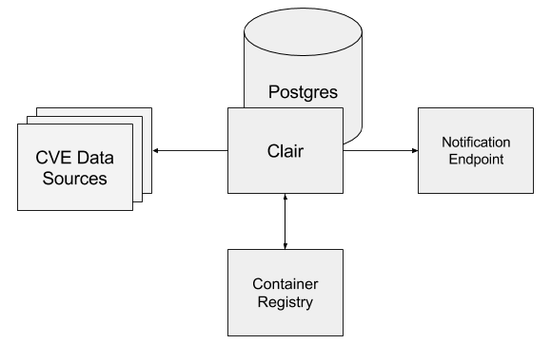
Clair Overview
Notes:
When Clair first starts, it begin consuming information from the provided sources (Debian, Ubuntu, RedHat, etc.) and building its local vulnerability database. It will update itself from the sources so that newly reported vulnerabilities can be reported. It can be integrated with container registries. Clair also provides a notification webhook where it can report when layers have new vulnerabilities.
Clair uses Postgres as a datastore both for vulnerability information and for information the scanned layers.
That’s an item of note. Clair doesn’t care about containers or images, Clair tracks and scans layers. To better understand what this means, let’s consider the anatomy of a Docker container.

Slide 21
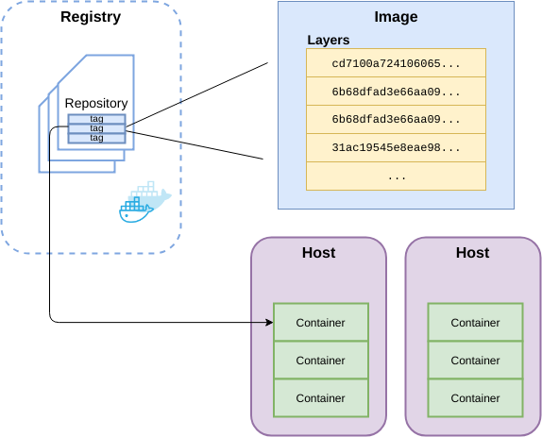
Anatomy of a (Docker) Container
Notes:
A Docker registry hosts repositories of containers. Docker has created a standard for compatible registries, so there is lots of choice here: Docker Hub, Quay, ECR, Artifactory, and more.
A Docker repository is a named collection of images, similar to a how a git repository is a named collection of related code artifacts. They are used to organize a registry.
Note: a registry and repository are not necessary to use Docker containers, but are part of the sauce which makes deploying Docker containers so delicious.
A Docker image is a named collection of layers, referred to by the name (which matches the repo) and a tag (a user-defined identifying string).
A layer is a single component of a container’s filesystem. Docker hashes each layer, and uses the hash to provide deduped storage on both hosts and the registry.
The term “container” fills 2 roles: to refer generally to the technology itself, or to reference a running instance of an image.

Slide 22
Demo

Slide 23
Docker Bench

Slide 24
What is Docker Bench?
Benchmark security of a Docker host node
Created and maintained by Docker
Uses CIS inspired ruleset
Can take custom rules
Notes:
Not going to demo this due to time.

Slide 25
Vulnerability
Lifecycle

Slide 26
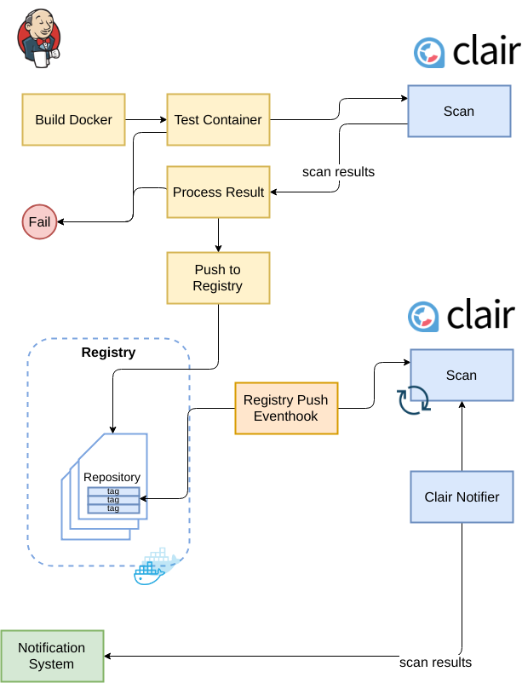
Notes:
Here’s a proposed (simplified) sample workflow using Clair with CI.
CI builds a container
Container is tested
CI calls an instance of Clair integrated with the CI platform to scan the container
Container scan results come back from Clair and are processed by the CI server
If the results to meet some threshold for vulnerabilities, the build fails
If the results are good enough, the image is pushed to the registry
When the registry push occurs, an event hook fires asking Clair to scan the image
Clair pushes results to a notifier, which sends alerts to your organization’s notification system
The image is rescanned on a schedule for new vulnerabilities, with detected vulnerabilities triggering a notification

Slide 27
Wrap-up
https://github.com/fork4/lfnw2018
Notes:
Many orchestration framework use these features as part of their container deployment, but attempt to express them in more human-readable ways. Now you may have a better understanding how they are doing limits or locking down containers. Everything shown here, except for the vulnerability scan results in Quay, uses features built in to, or are practices applied to, freely available Docker and Docker Engine.

